Slide 2
Project Overview
Abstract
Statement of the Problem
Objectives
Expected Outcome
Literature Review
Methodology
Results and Discussion
Recommendations and Conclusion
Outline

Slide 3
Overview
It is estimated that 1.2 trillion kilograms of waste are produced across the world yearly.
A study done in Nairobi county revealed that garbage recycling has the ability to generate 13.5 billion Kenya shillings in Plastic bottles revenue.
In the JKUAT case study, the use of the different garbage bins for sorting trash has proven to be ineffective.
Waste sorting is an important process that precedes garbage recycling and disposal. The recyclable materials can even provide a steady revenue stream.
Metal cans e.g. Aluminum cans.
Glass bottles
Notes:
8/10/2018
2

Slide 4
Abstract
Problem associated with garbage disposal
Current garbage management systems
Inefficiencies and gap associated with current systems
Solution adopted focusing on:
metal
glass
plastic
Garbage Control
Garbage Sorting
Promote Recycling
Notes:
8/10/2018
3

Slide 5
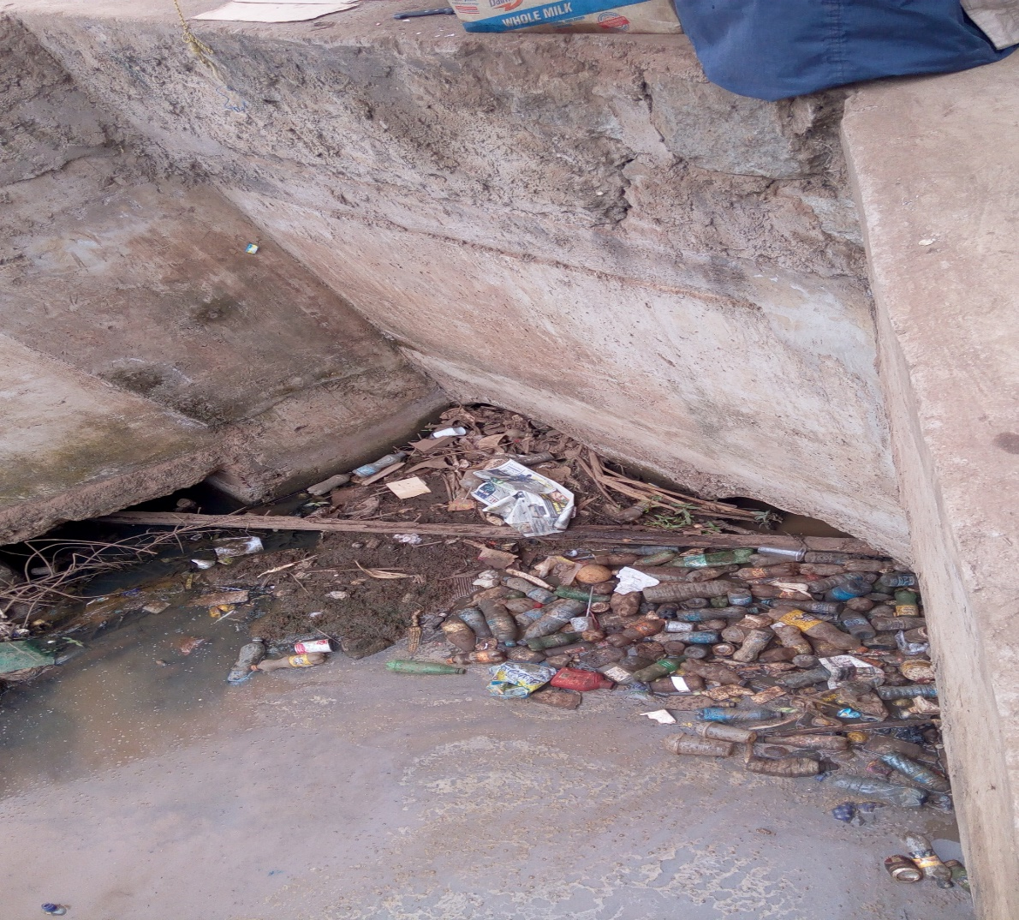
Problem Definition
Tons of garbage are produced around the school on a daily basis.
The Prevailing systems that are currently being used are ineffective.
Its from this data that the most profitable materials to recycle was decided upon.
[http://www.iea.org/]
Fig 1: Drainage System at the JKUAT Main gate
[http://www.effectofglobalwarming.com/]

Slide 6
Objectives
Main Objective:
To design and fabricate garbage waste separation and sorting system that will avail an avenue for the successful aggregation of recyclable waste for purposes of recycling and reuse.
Specific Objectives:
To design, fabricate and test a garbage separator that will provide a steady stream of waste that is fed one item at a time to the sorting system while removing unwanted particulate matter.
To design, fabricate and test a garbage sorter that will successfully identify and sort the waste as per the specified categories.
Notes:
8/10/2018
5

Slide 7
Justification and Expected Outcome
Garbage waste sorting is an important process that precedes garbage recycling and disposal.
It is estimated that 1.2 trillion kilograms of waste are produced across the world yearly.
Garbage recycling has the ability to generate 13.5 billion Kenya shillings in revenue in Nairobi County.
At the end of this project, the following outcomes were expected:
Garbage separation- The mechanism will work such that from a heap of garbage loaded into the machine, itemization/singularization of the garbage will be achieved.
Garbage sorting-The sorting system will identify and categorize each garbage item according to the type of material.
The integration of the garbage separation and sorting system should be effective in sorting garbage.

Slide 8
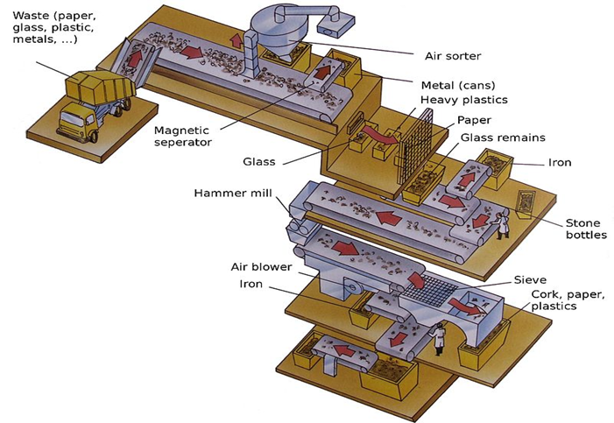
Literature Review
Material Recovery Facilities
The clean MRF and dirty MRF
How do they do it?
Trommel separators/drum screens
Eddy current separator
Induction sorting
Capacitive sensing sorting
Near infrared sensors (NIR)
X-ray technology
Fig 2: MRF

Slide 9
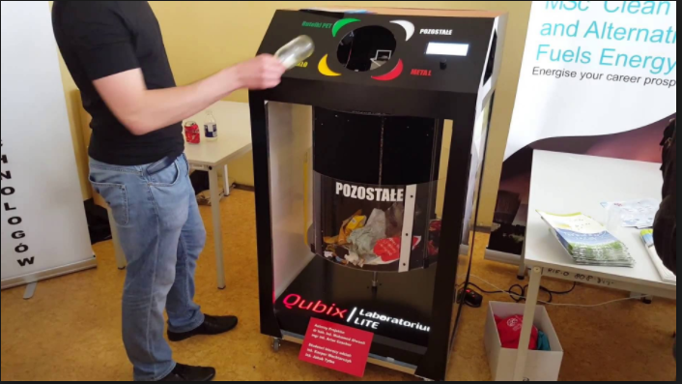
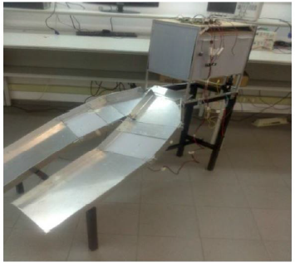
Literature Review
Student Projects :
Fig 3:Automatic Waste Separator(AWS) Fig 4: The intelligent waste separator(IWS).
Gap Analysis:
Most of the these projects are designed to only sort the garbage if its only put into the garbage bin one item at a time.

Slide 10
Methodology
The system is divided into two categories namely:
1. Garbage separation - this process entails the separation of accumulated trash into single entities to be fed into the system where sorting will take place.
2. Garbage sorting - this process involves the categorization of the provided single entity of waste. The categories of waste in sorting include plastics, metal can, glass and other waste.

Slide 11
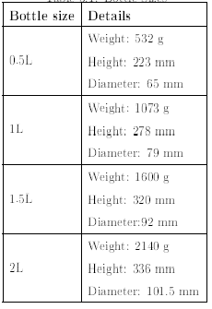
Design Considerations (General)
Size of the garbage
Weight of the garbage
Material
Cost
Geometry
Skill and expertise
Type of motion
Power requirements
Efficiency
Table 1:Bottle Sizes

Slide 12
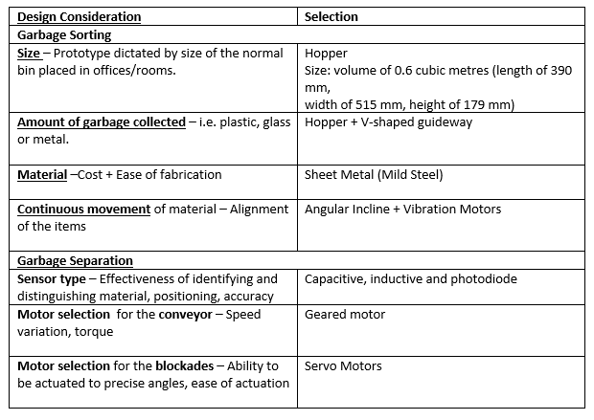
Design Considerations

Slide 13
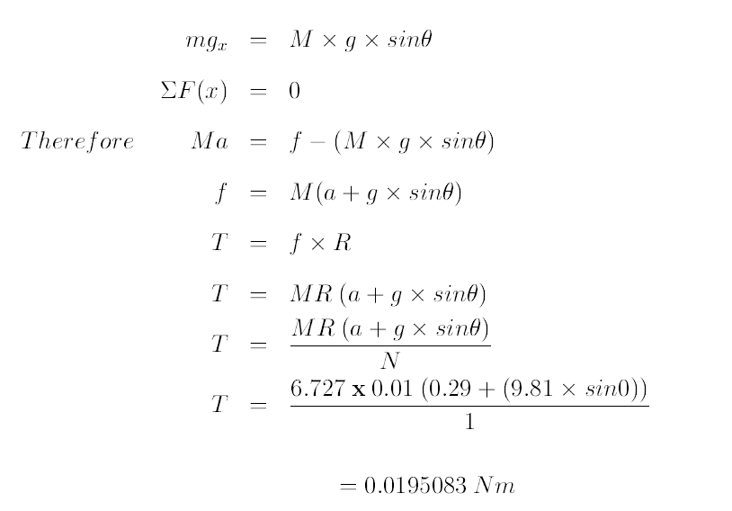
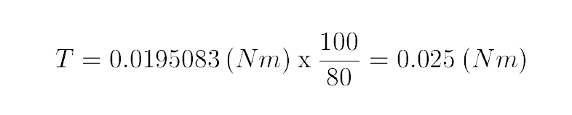
Design Calculations
Motor Sizing:
Fig 5: Rolling Wheel

Slide 14
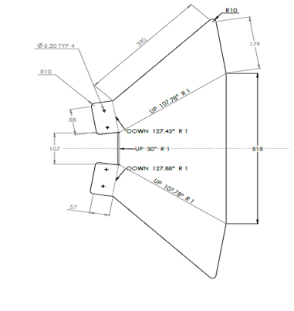
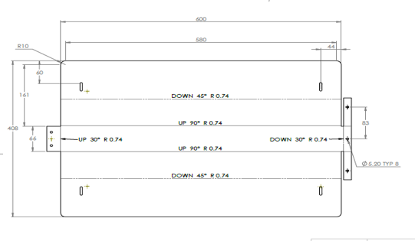
Garbage Separation
Fig 6 :2D Designs

Slide 15
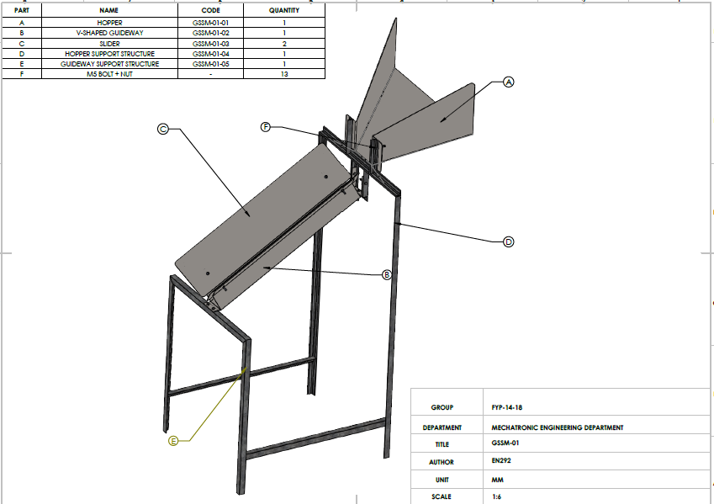
Garbage Separation (Integration)
Fig 7 :Garbage Separation

Slide 16
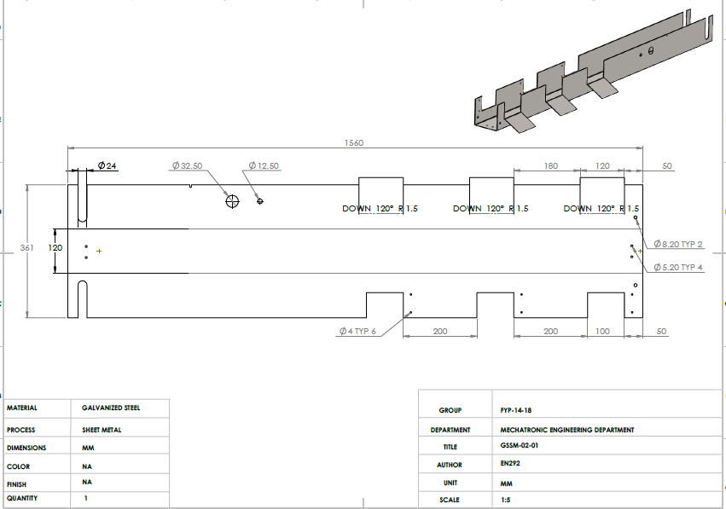
Garbage Sorting Design
Fig 8 :Garbage Sorting

Slide 17
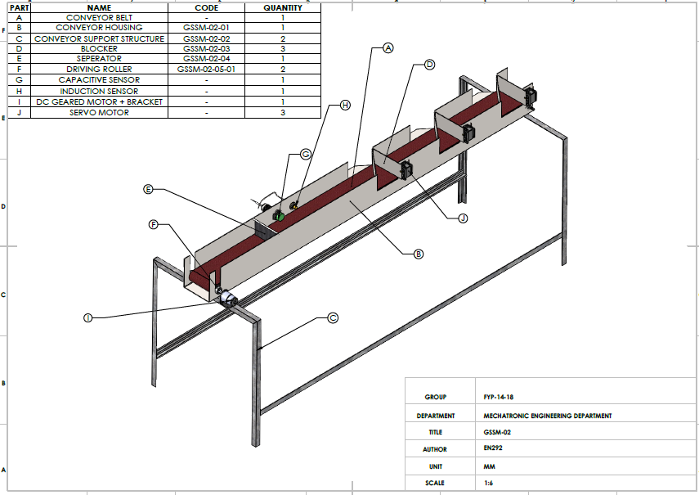
Garbage Sorting (Integration)
Fig 9 :Garbage Sorting

Slide 18
Redesigns
System Height
Metal Crushing Unit
Empty metal can collected at a Materials Recovery Facility are usually first separated into steel and aluminium, then crushed, baled and sent to re-
Processors.
Fig 8 :Metal Crushing Unit

Slide 19
Design Considerations: Metal Crushing Unit
Method of actuation
22.2411 N to 88 N force required to crush all aluminum beverage from tests conducted.
A stroke length that is more than 170 mm and 115 mm which are the lengths of the largest and smallest metal cans that will be sorted.
2. Mounting
Fig 9 :Linear Actuator
12V DC, stroke length- 200 mm, static load- 300N
which is sufficient to crush the metal cans being sorted, speed- 30mm/s.

Slide 20
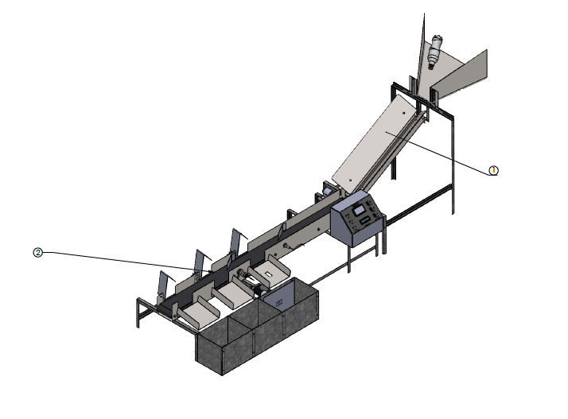
Garbage Sorting and Separation (Integration)
Fig 10 :System Integration

Slide 21
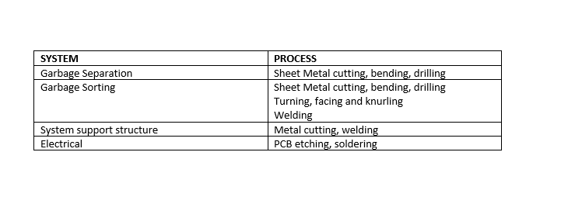
Fabrication Process
Table 3:Fabrication Process

Slide 22
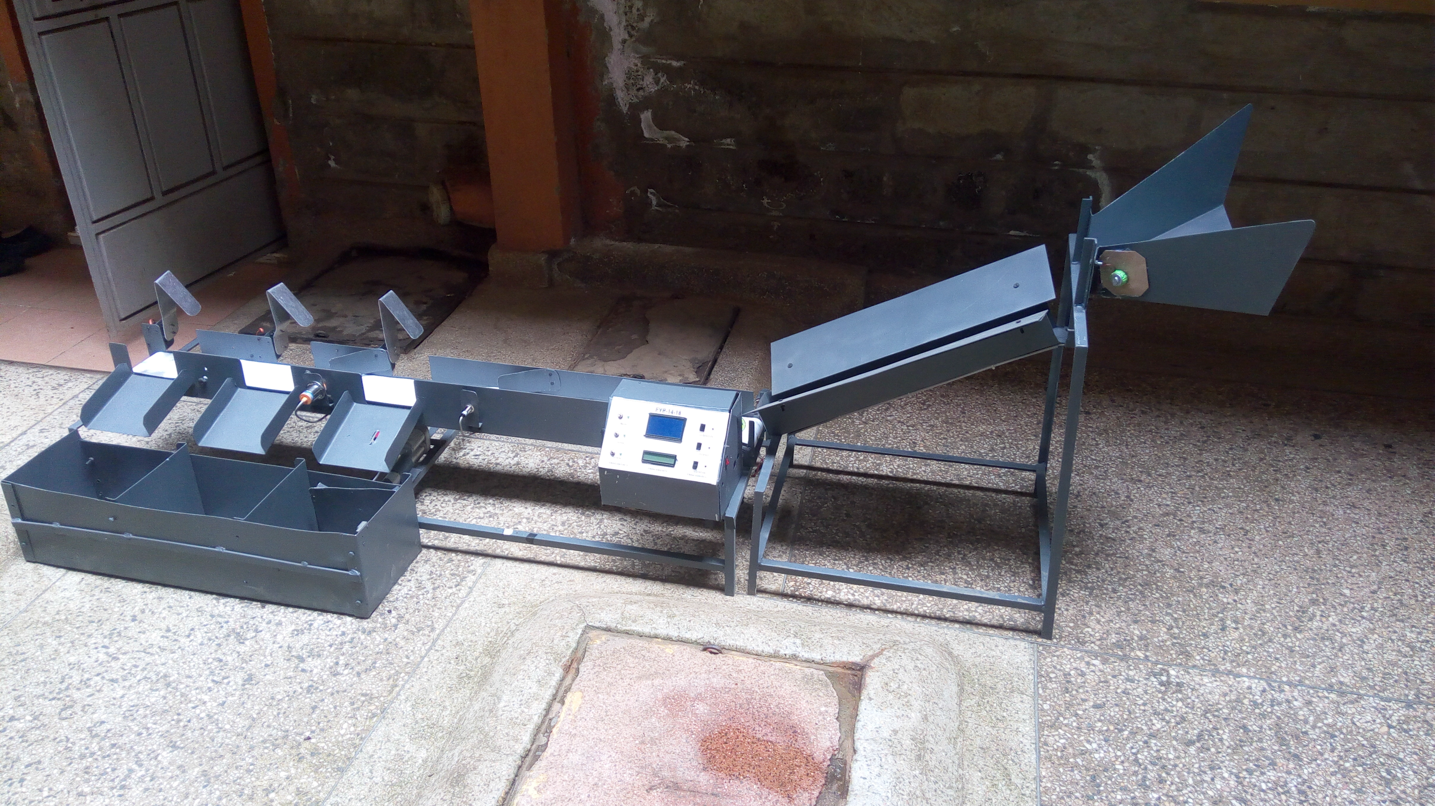
Mechanical Structure
Fig 11 :Mechanical Structure

Slide 23
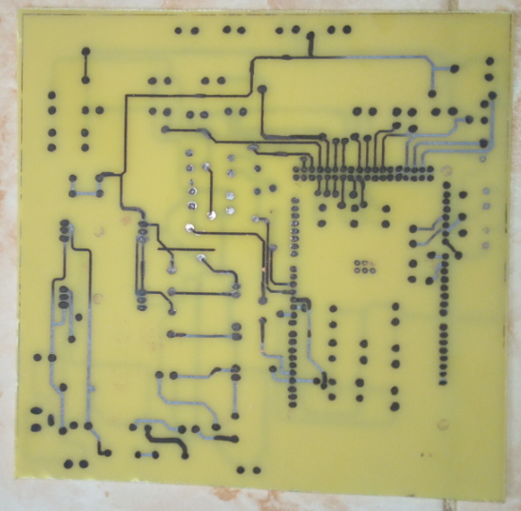
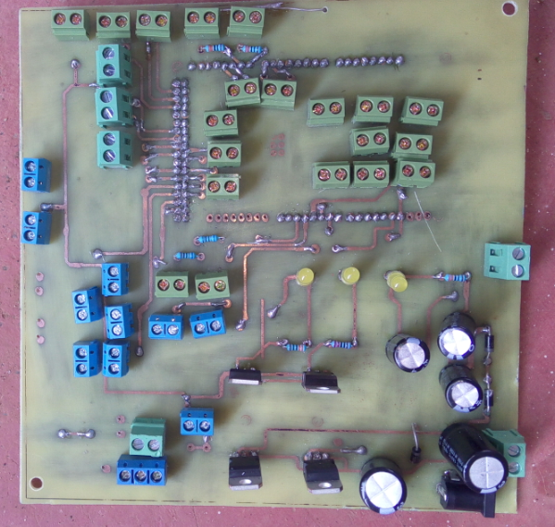
Electrical Circuit
Fig 12 :Etched PCB
Fig 13: Mounting of components

Slide 24
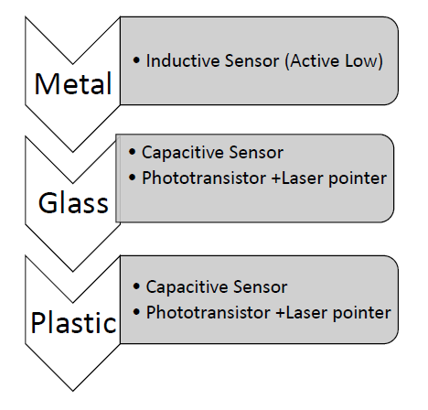

Results and Discussion
Material Detection:
Material | Detection
Metal
Glass
Plastic

Slide 25
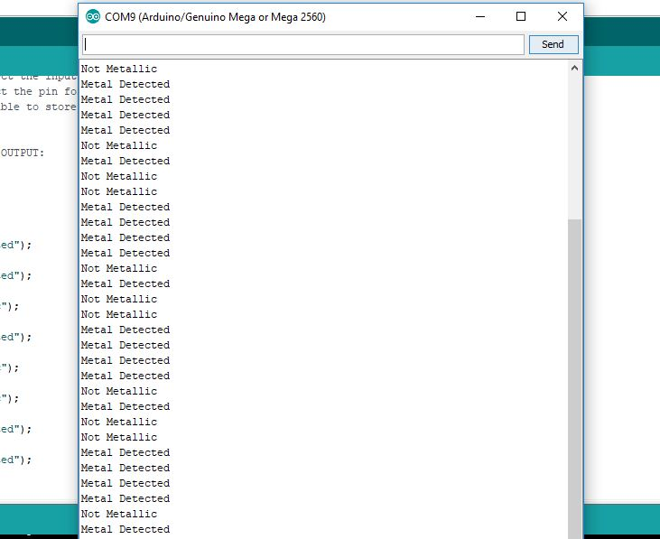
Results and Discussion
Material | Detection Time | Detection Accuracy
Metal | 2 sec | 95%
Glass | 3 sec | 87%
Plastic | 5 sec | 77%
Values obtained from the number of materials used during testing.
How many bottles can be sorted in a minute?

Slide 26
Challenges and Recommendations
Challenges:
Sensor range :limited range of between 2 mm- 5 mm.
2. Material separation and spacing-
Due to the difference in size of the garbage items being sorted, it was difficult to properly singularize and space the garbage items as
they got onto the conveyor.
3. Motor Torque and Conveyor Material
Lag of the conveyor when carrying heavier materials.
Recommendations:
1.The acquisition of sensors with the required range should be done earlier.
2. To effectively separate and space the garbage materials, there's need to add an extra mechanism that will facilitate the entry of materials in the conveyor one at a time.
3. The proper industrial grade conveyor belt should be used for the conveyor belt to avoid slip and sagging when in operation.

Slide 27
Conclusions
The main objectives met include:
Garbage separation
Garbage sorting
Garbage sorting and separation
Advantages of the system:
1. The separation and sorting of waste has introduced some autonomy hence reduced human effort.
2. The system can be modified to separate other kinds of waste which are not necessarily aluminum cans, plastic bottles, or glass.

Slide 28
Thank you for your attention.
Q/A

Slide 29
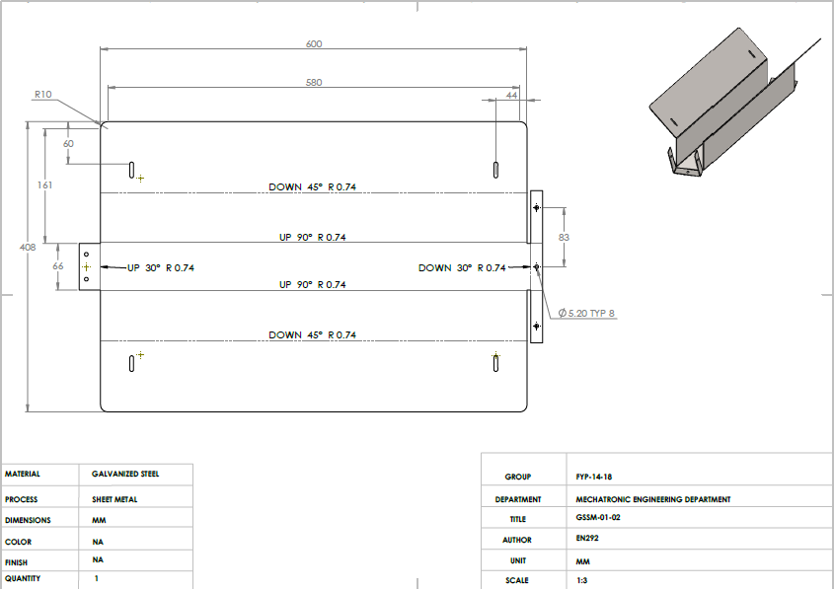
Design of the V-shaped guideway

Slide 30
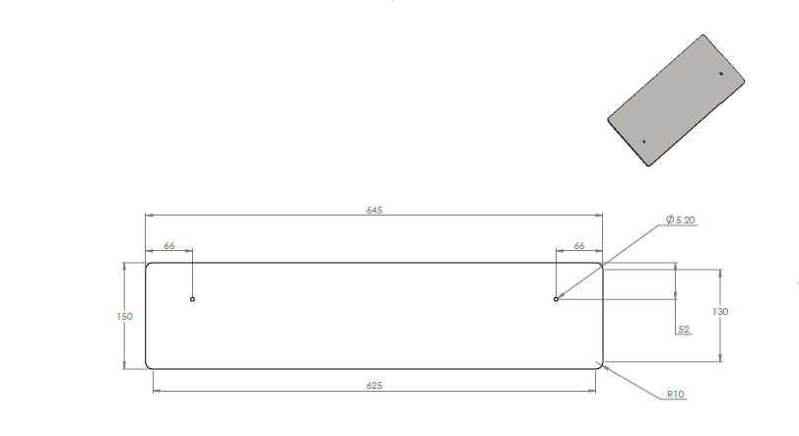
Design of the slider

Slide 31
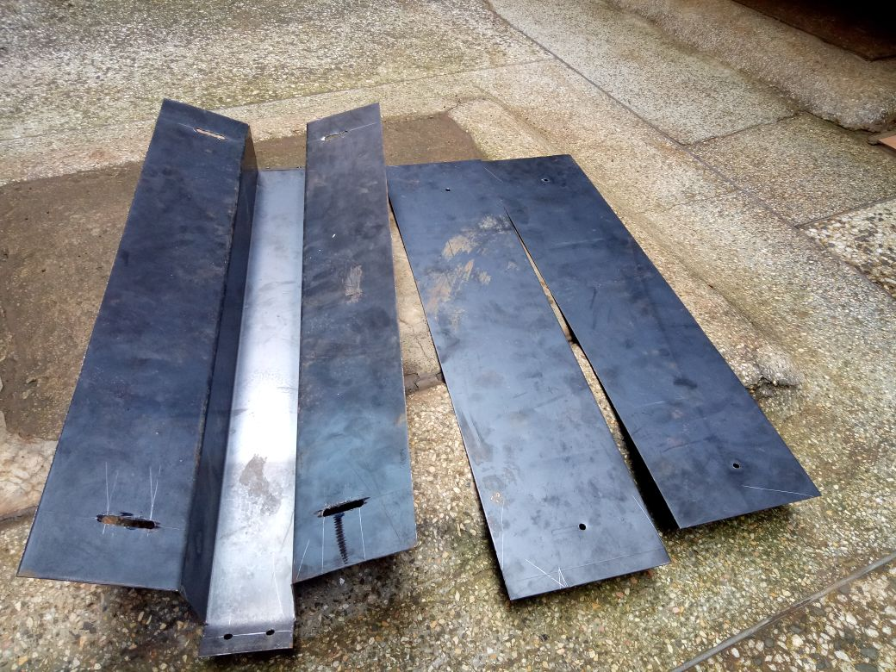
Progress

Slide 32
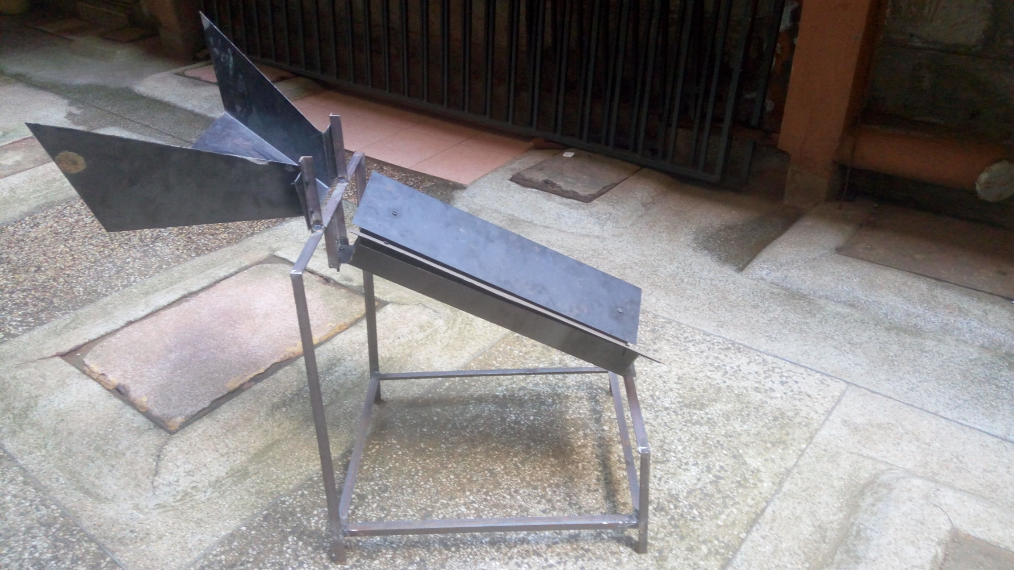
Progress

Slide 33
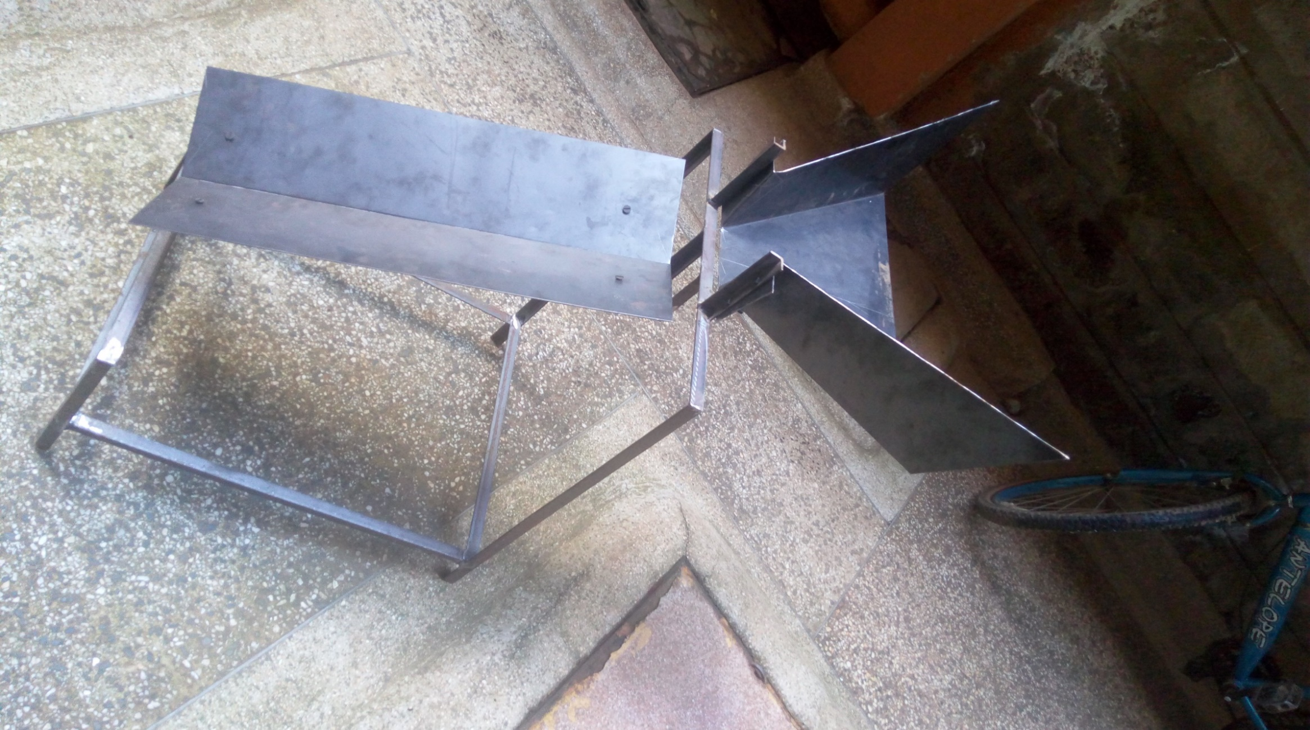
Progress

Slide 34
2)GARBAGE SORTING
Sorting System
The garbage from the separation system is delivered to the sorting system.
It consists of :
Delivery mechanism (Conveyor)
Detection unit
Blocking mechanism
Delivery mechanism
The design considerations include:
Type of motion
The dimensions/size of the garbage
The weight of the garbage

Slide 35
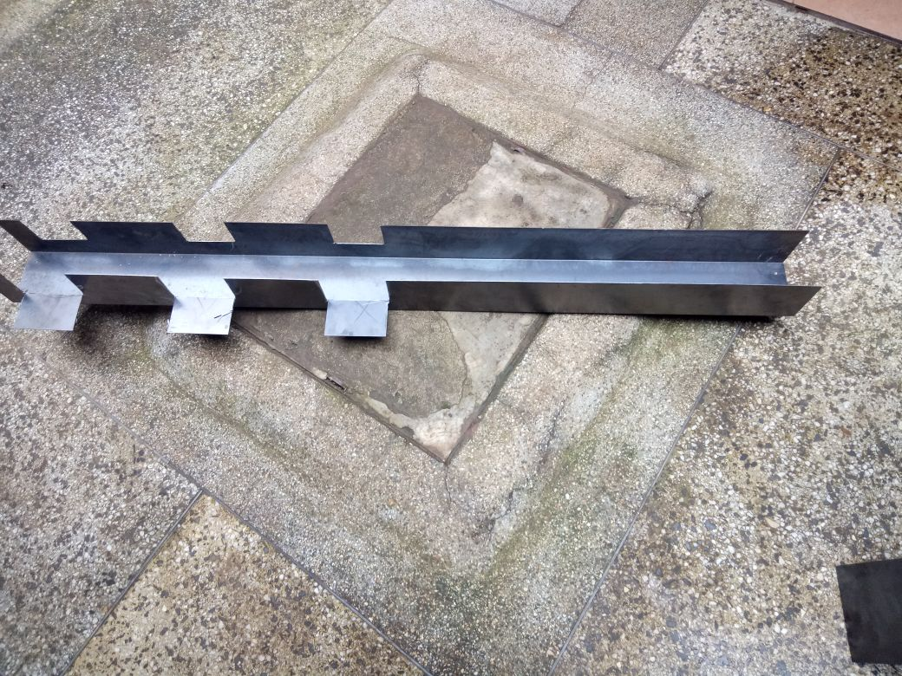
Progress

Slide 36
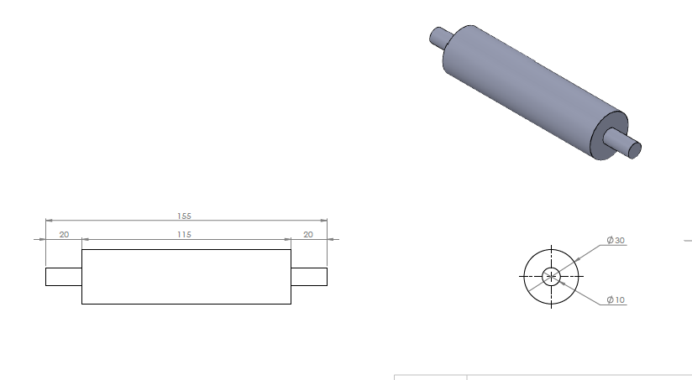
Design of the Rollers (driver)

Slide 37
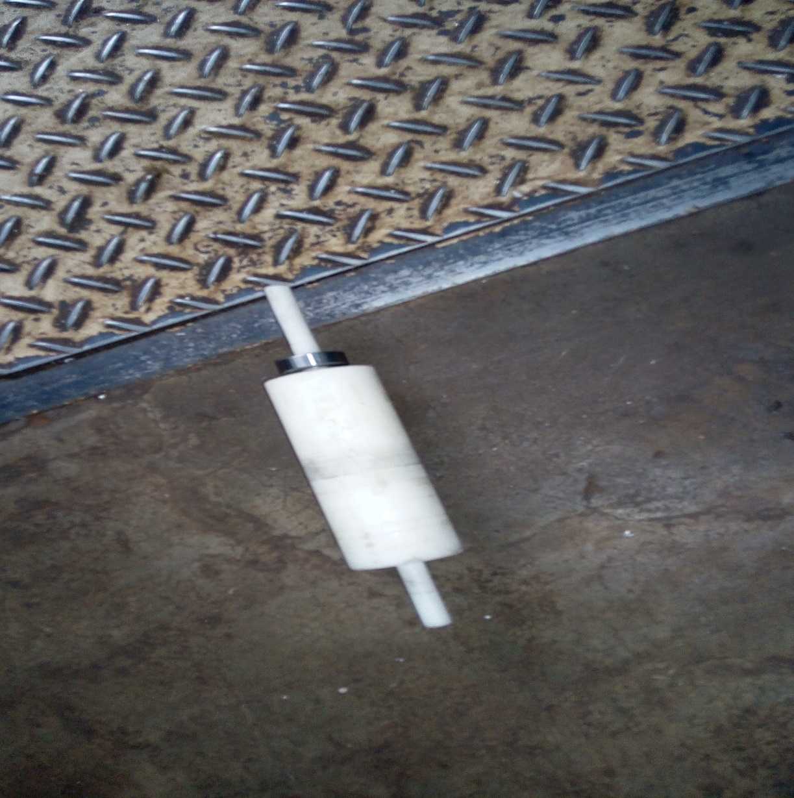
Progress

Slide 38
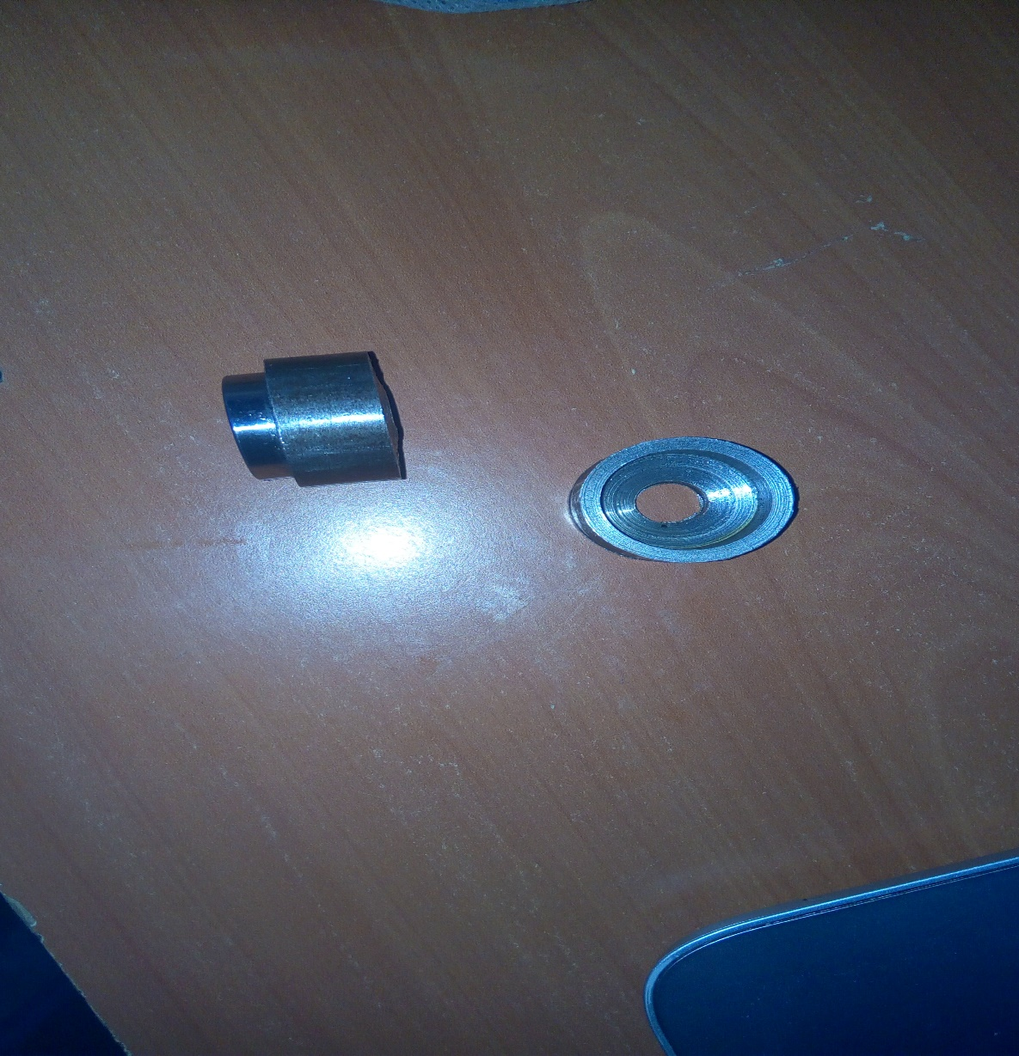
Progress-bearing housing

Slide 39
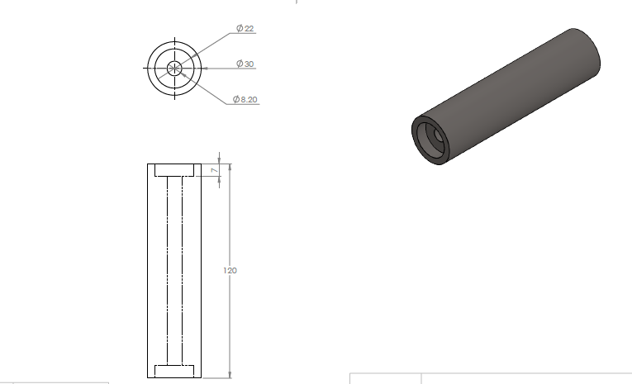
Design of the Rollers (driven)

Slide 40
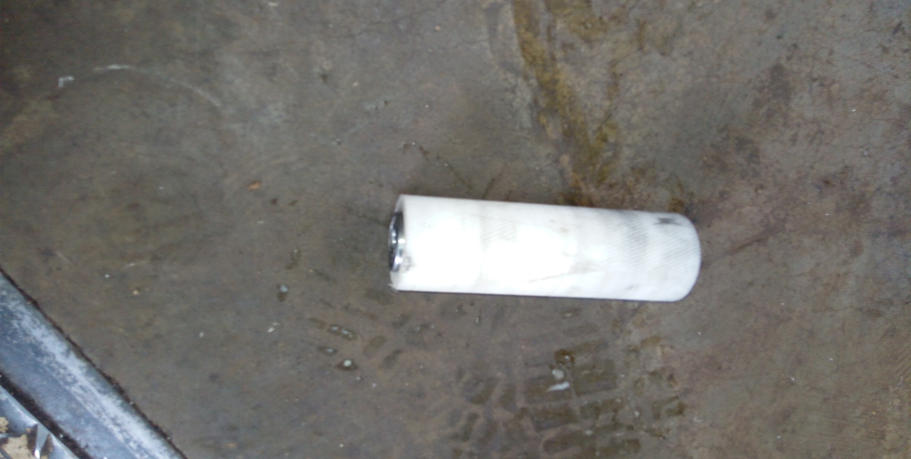
Progress

Slide 41
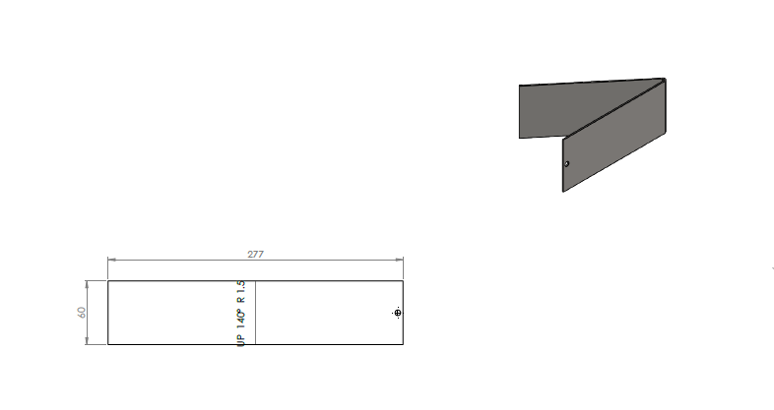
Design of the blocking system

Slide 42
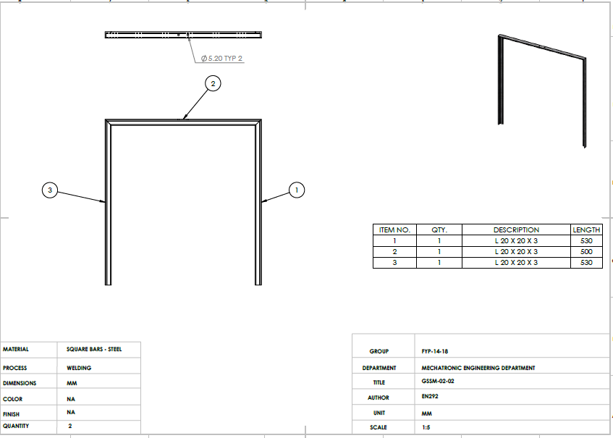
Design of the Support Structure(conveyor)

Slide 43
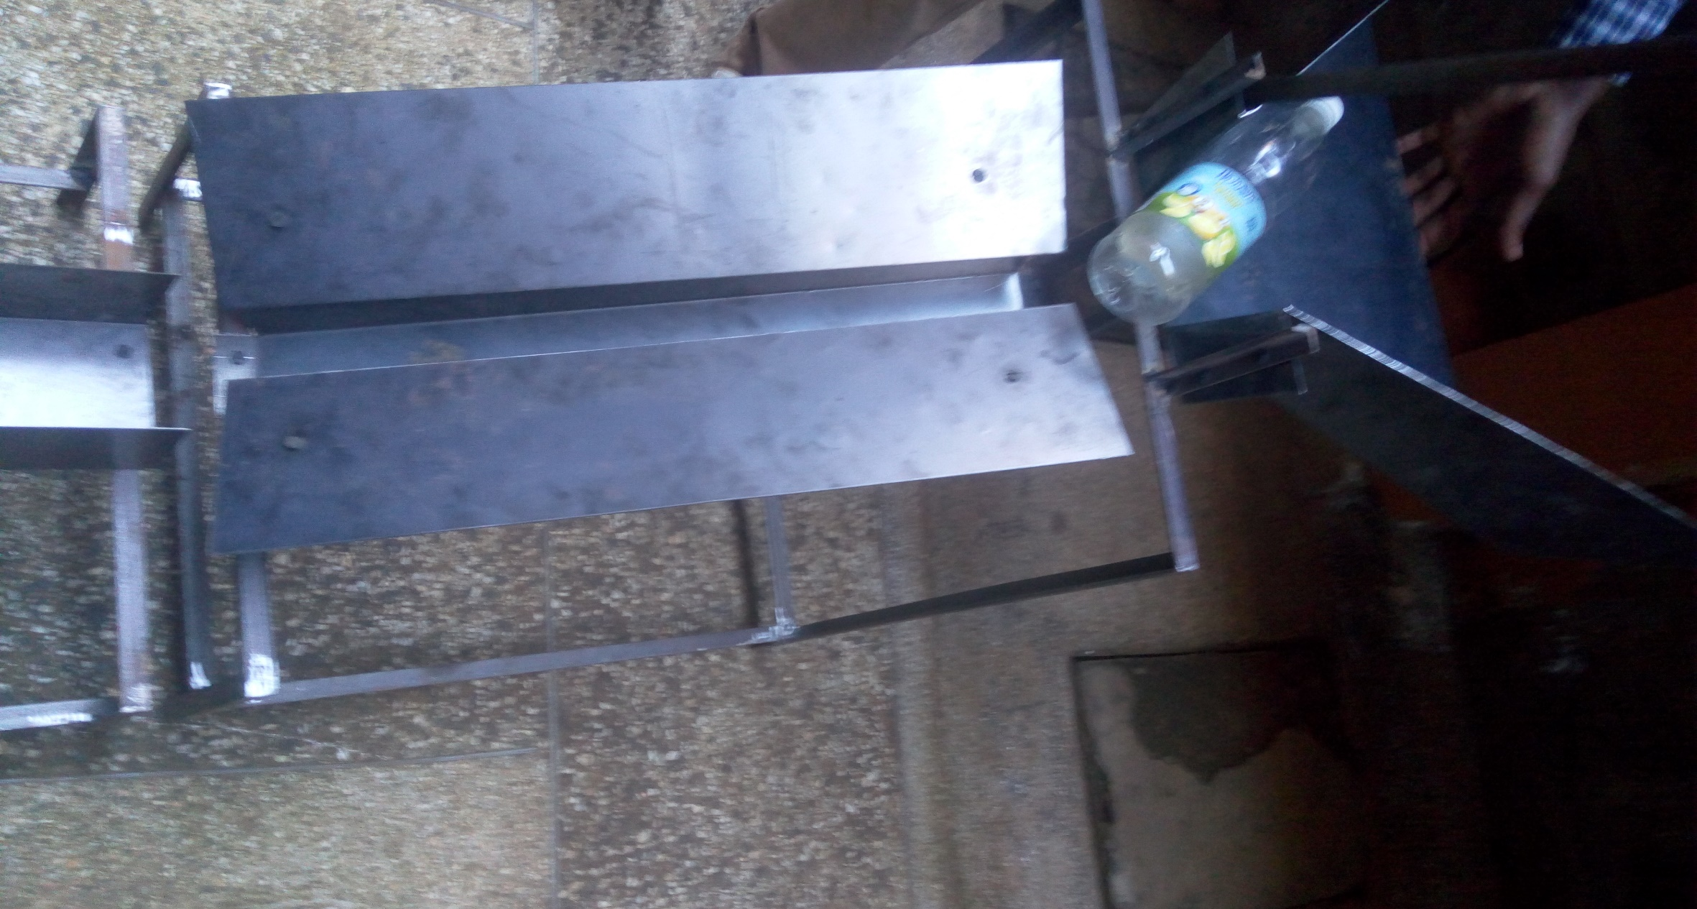
Progress

Slide 44
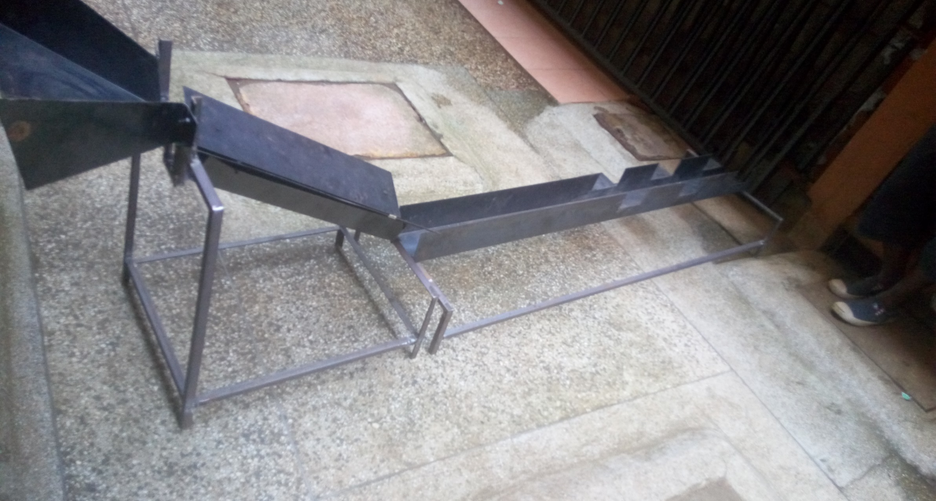
Progress

Slide 45


Motor Selection
Motors acquired include:
1 geared motor
3 Servo motors
Individual testing has been done.
The motor coupler has been acquired.

Slide 46
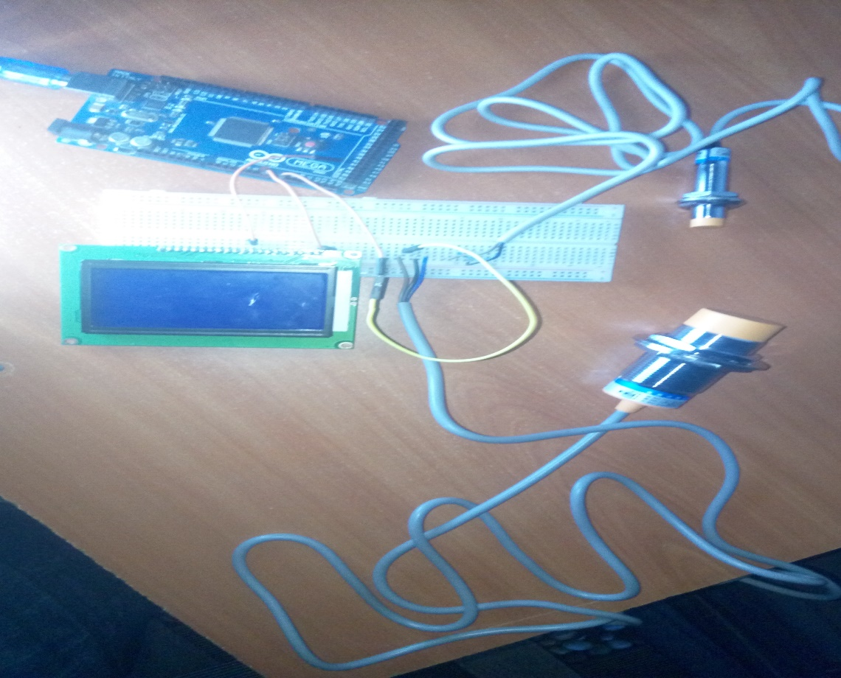
Detection Unit
Sensors acquired:
2 Capacitive sensors
1 inductive sensor
Phototransistor
Photoelectric Sensor
Individual testing and fine tuning to detect the materials being sorted is ongoing.

